Slide 1
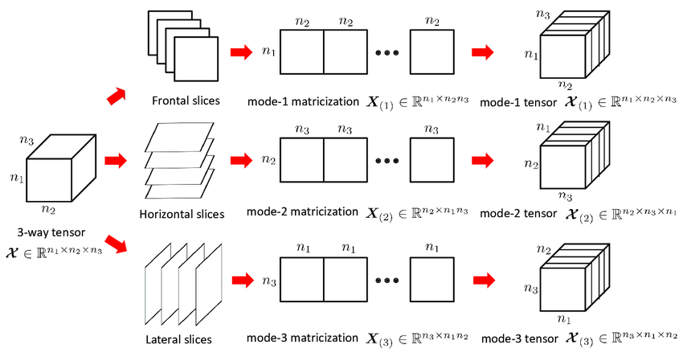

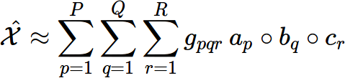
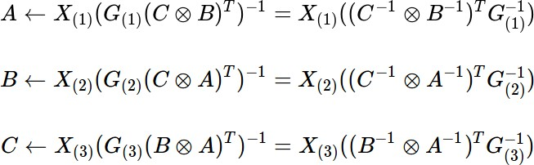

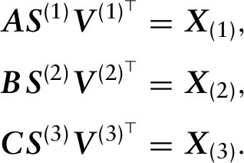
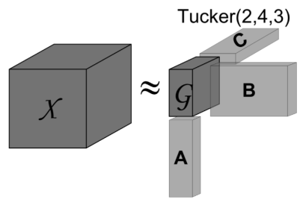

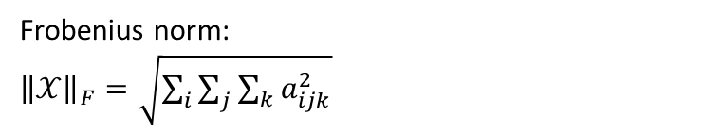

Lecture 12
Tensor:
Tucker3:
by
Alternating Least Squares:
$$G←$$
Initialize by HOSVD or random:
You are not guaranteed a global optimum with alternating least squares and therefore it is often
beneficial to run the algorithm a couple of times with different initializations.
Frobenius norm:
${\left\|𝒳\right\|}_{F}=\sqrt{\sum_{i}{\sum_{j}{\sum_{k}{a_{ijk}^{2}}}}}$
Kronecker product:
Notes:
Gini er konventionen til opbyggelse og miss class er til prune

Slide 2
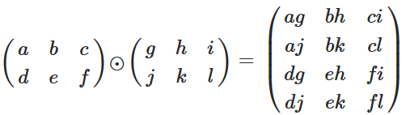
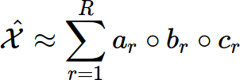
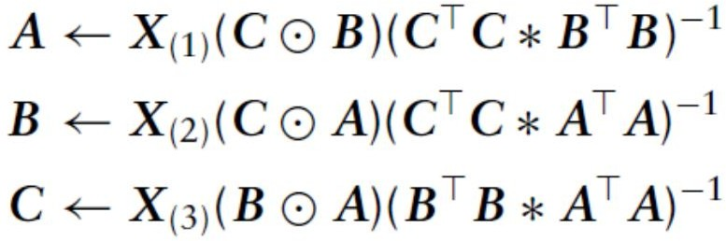

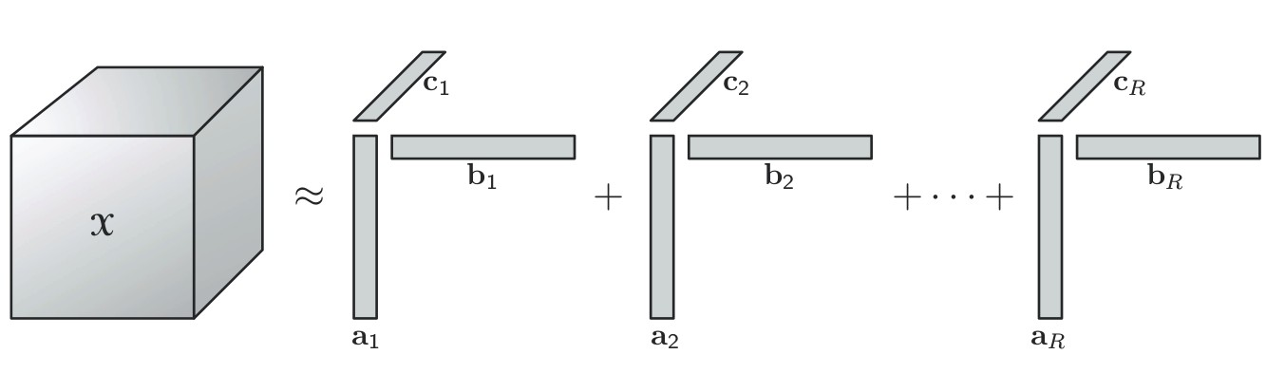

Lecture 12
Khatri-Rao product:
Pros and cons:
Tensor decomposition models are in general good with domain knowledge
PARAFAC can split mixed into original components.
TUCKER has in general larger adaptability but lack uniquness
Uniqueness:
Given the property of the super diagonal core tensor PARAFAC models yield unique solutions
The Tucker model is not unique, as such multiplying by an invertible
matrix Q^{LxL} gives an equivalent representation
Parallel factor analysis:
by
Alternating Least Squares:
Test of PARAFAC model:
Initialize by HOSVD or random
$$G←$$
Notes:
Gini er konventionen til opbyggelse og miss class er til prune

